Slide 1
Radiation and Prostate Cancer
Past, Present and Future
Dr. Tom Corbett
MD FRCPC
Juravinski Cancer Centre

Slide 2

We’ve come a long way!
Notes:
Not all prostate cancers are the same.
Nor are all men the same (different priorities).

Slide 3
Goals
Review the basics of prostate cancer
Review a brief history of radiation therapy
Discuss the new advances in radiation treatment as they apply to prostate cancer

Slide 4
Prostate Cancer
The Basics

Slide 5


Slide 6
Prognostic Factors
  PSA
  Gleason Score
  T Stage

Slide 7
PSA
Prostate Specific Antigen
Normal value is <4 ng/ml, but varies with age, size of prostate, benign prostatic changes (inflammation)
Higher values usually indicate a greater amount of cancer.
PSA versus free-PSA

Slide 8
Gleason Score
A description by the pathologist of how the cancer looks under the microscope.
Scores range from 2 to 10.
Scores of 2-6 are generally slow growing.
Scores of 7 are average.
Scores of 8 to10 are more aggressive.

Slide 9
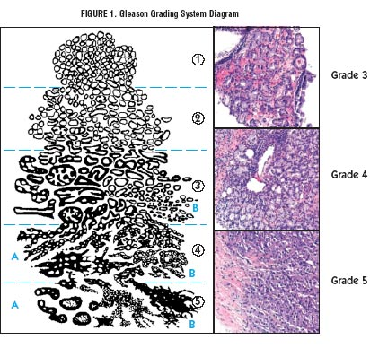

Slide 10
T stage
Refers to how the prostate feels on “the finger check” or DRE (digital rectal examination)

Slide 11
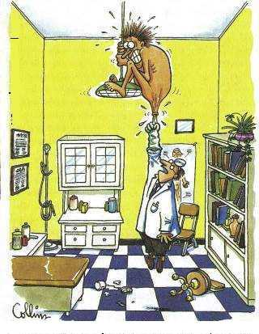

Slide 12
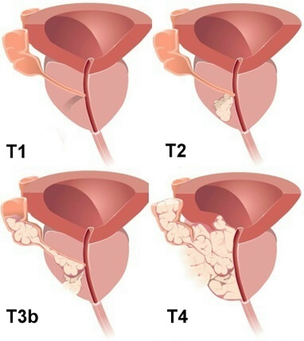

Slide 13
Risk Categories
Low Risk | All of: ≤ T2a PSA ≤10 Gleason ≤ 6
Intermediate Risk | ≥ T2b PSA ≤ 20 Gleason ≤ 7
High Risk | Any ≥ T3a PSA >20 Gleason ≥ 8

Slide 14
Brief History of Radiation
X-rays
First found in 1875
First studied in 1895
First used to treat cancer 1896

Slide 15
Early X-Ray Treatment
Limited by energy (20 – 150 kV)
  Treatments limited to superficial structures (not-penetrating enough for deep tissue)
Limited knowledge of radiation biology
  Single treatments not as effective as more fractions.
  Toxicity (acute and delayed) to normal tissues not appreciated.
Limited knowledge of radiation physics
  Usually treated with a direct single beam of radiation. No planning for multiple beams to cover the tumor.
Continued…..

Slide 16
Limited imaging ability
  Unable to adequately define the target to be treated. Surface anatomy often used to locate “tumor” -> larger treatment volumes required to ensure that tumor was treated.
  Unable to ensure that what was defined was actually being treated.
Limited knowledge of cancer behaviour.

Slide 17
Early advancements
Focused on increasing energy.
As energies increased to 500 kV, deep-seated tumors were being treated.

Slide 18
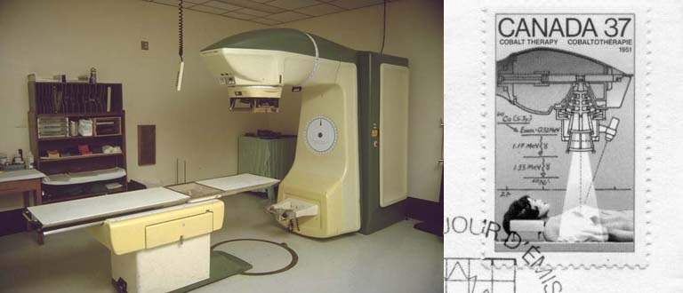
Cobalt Changed The Game

Slide 19
⁶⁰Co
A significant increase in beam energy: 1.17 and 1.33 MV.
-> allowed for deeper penetration with less skin damage

Slide 20
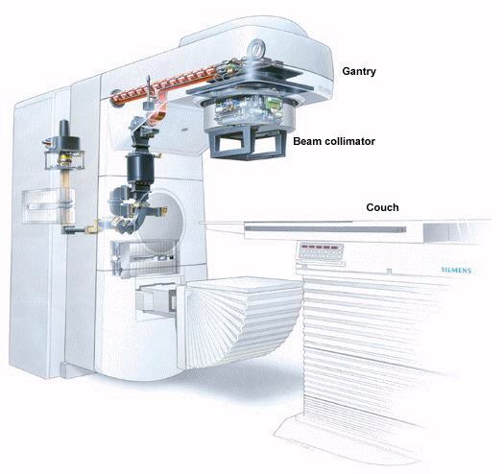
Linear Accelerators

Slide 21
Compared to ⁶⁰ Co:
Allowed for higher energies 4-25+ MV
  Deeper tumors could be treated safely without damaging the skin
Allowed quicker treatment times

Slide 22
Progress
Advances in imaging
Advances in computers
Advances in radiation treatment equipment.

Slide 23
Advances In Imaging
CT / MRI
IGRT

Slide 24
Volume Definition
  Consensus statements for defining volumes for:
- Prostate bed
- Pelvic Lymph Nodes

Slide 28
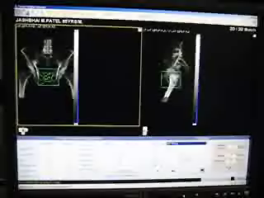
Advances in Imaging

Slide 29
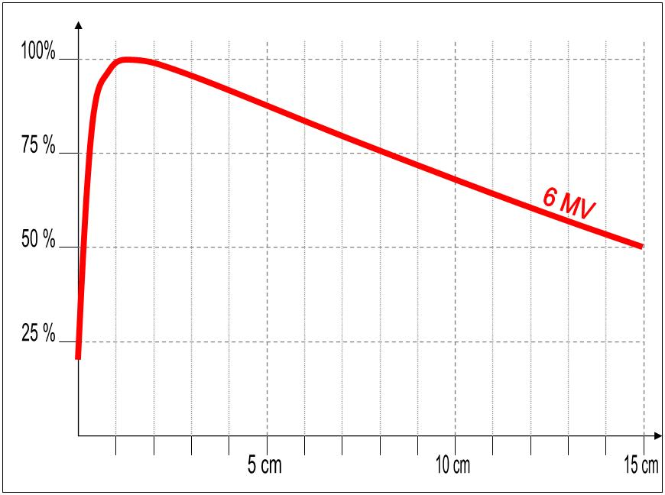
Advances in Computers
Originally all calculations were done by hand.

Slide 30
Made plans with more than 2 beams cumbersome.
Calculations for odd shapes were difficult to account for.

Slide 31
NOW
Computers are capable of doing millions of calculations per second
Allows for newer technologies to delivered reliably and accurately

Slide 32
Process of Radiation Planning
CT simulation
outlines the prostate, bladder, rectum
Planning
coming up with a plan to give the proper dose to the prostate without giving too much to the normal tissues.
Treatment
daily (Monday-Friday) for 35 – 39 days.

Slide 33
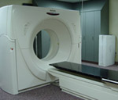
CT simulation
Notes:
CT scan with full bladder, empty rectum

Slide 34
Planning
Will review progress later.
Notes:
Planning – adds a margin around the prostate to allow for motion due to bladder or rectal filling.

Slide 35
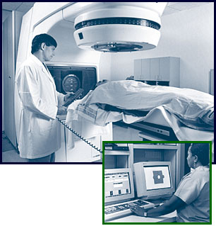
Treatment

Slide 36
Advances in Radiation Equipment
IMRT
VMAT
IGRT
Cyberknife

Slide 37
IMRT
Intensity Modulated Radiation Therapy
Focuses radiation more tightly on the prostate.
Need to be able to identify the prostate before giving the radiation dose
  Gold seeds
  Daily CT scan
  Daily ultrasound localization

Slide 38
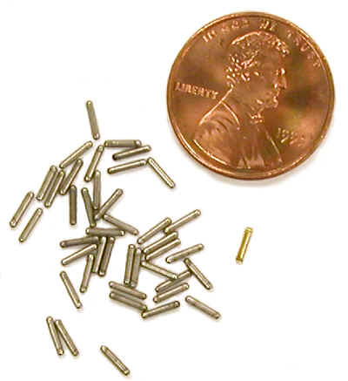
Gold seeds
Notes:
Gold – doesn’t react with body; dense so can be seen on treatment.
Put in with transrectal ultrasound (like the biopsy in reverse)
23 Kt gold – small (don’t need to mention in the will)

Slide 39
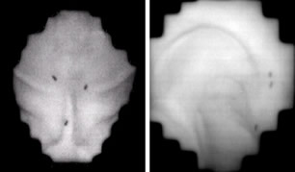

Slide 40
A Look AT Progress:

Slide 41
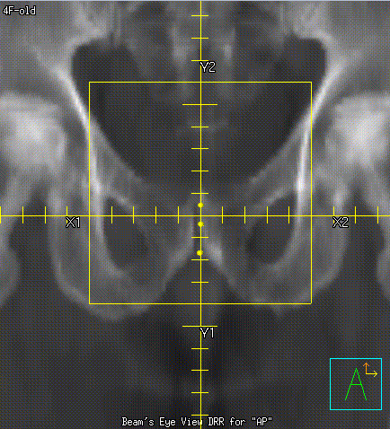
Old Technique – 4 field
Ant old old

Slide 42
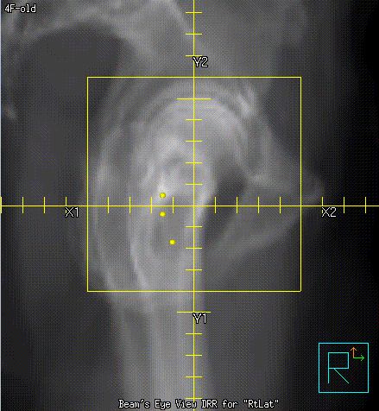
4 Field
Old r lat

Slide 43
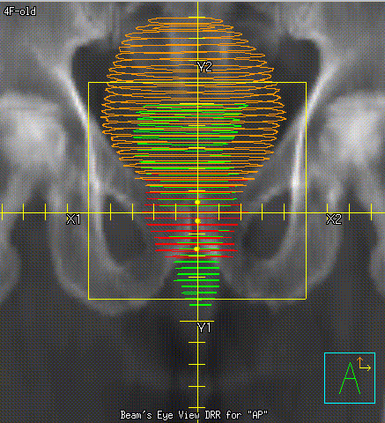
4 Field Old
4 field ant volumes

Slide 44
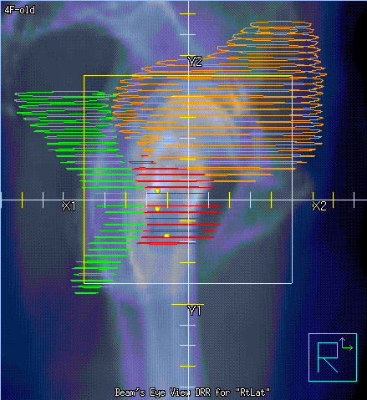
4 field Lat volumes

Slide 45
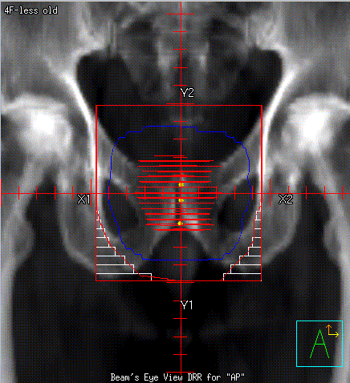
4 field – less old
ant

Slide 46
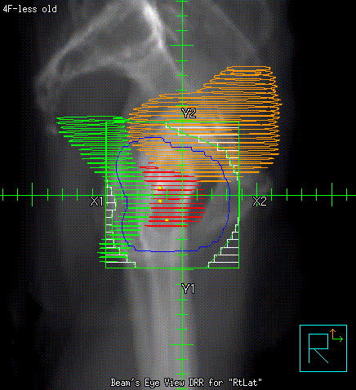
4 field less old
R lat

Slide 47
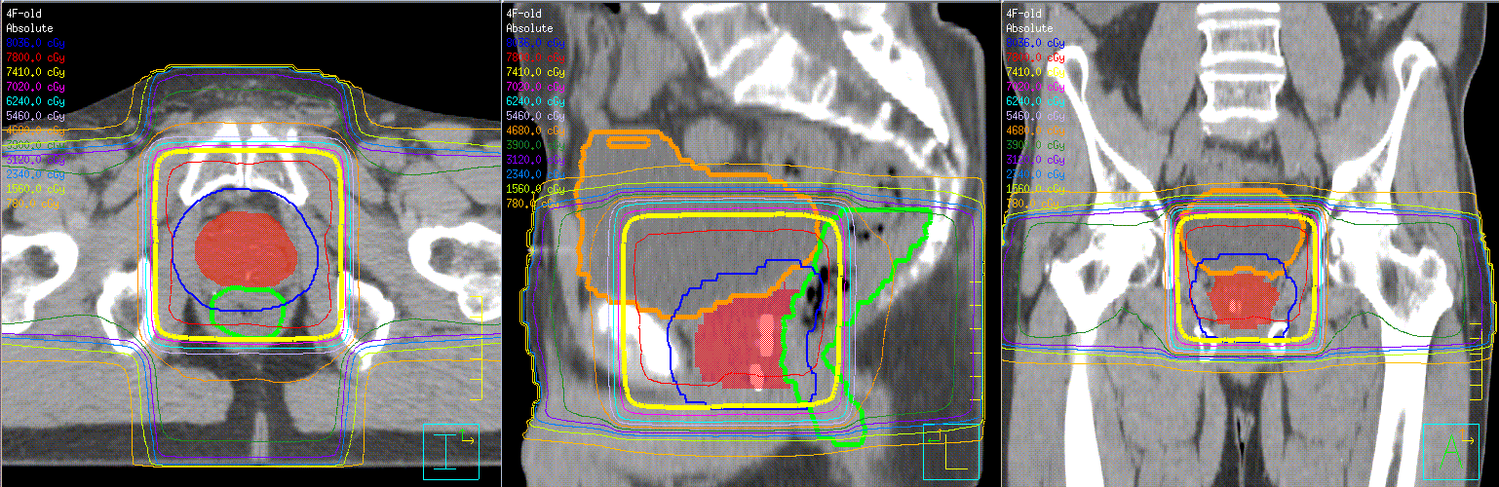
Distribution
4 field old old

Slide 48
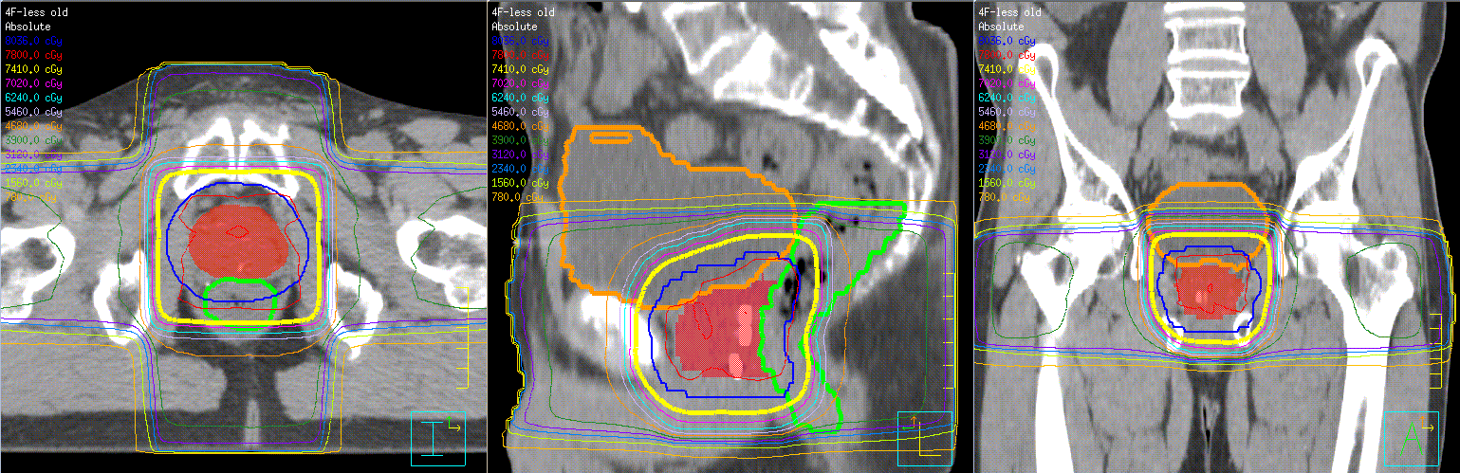
Distribution
4 field less old

Slide 49
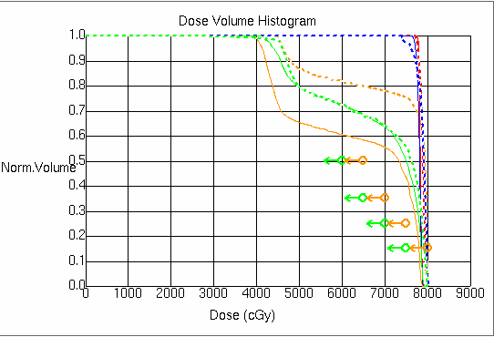
DVH – old vs less old

Slide 50
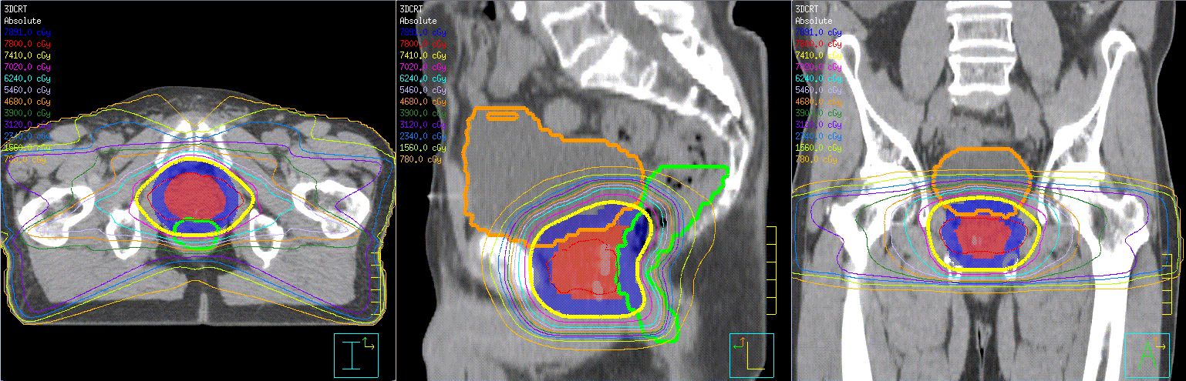
Distribution – 3D conformal

Slide 51
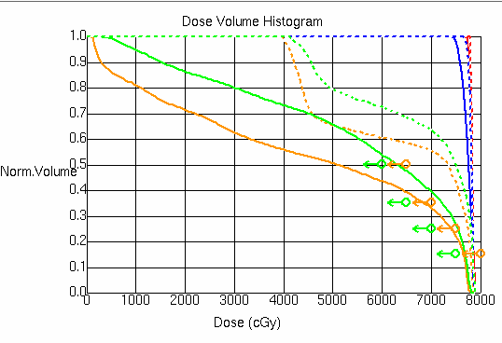
DVH – less old vs 3D CRT

Slide 52
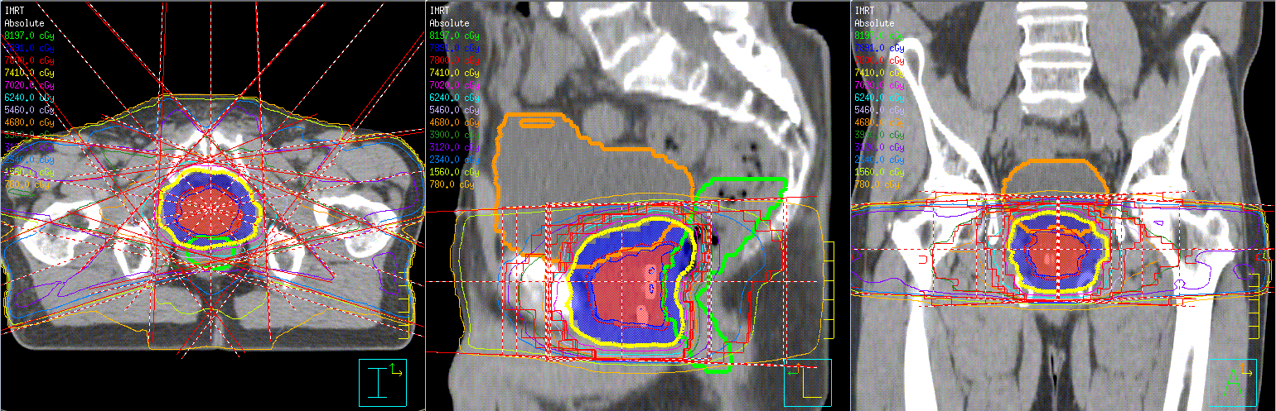
Distribution IMRT
With beams

Slide 53
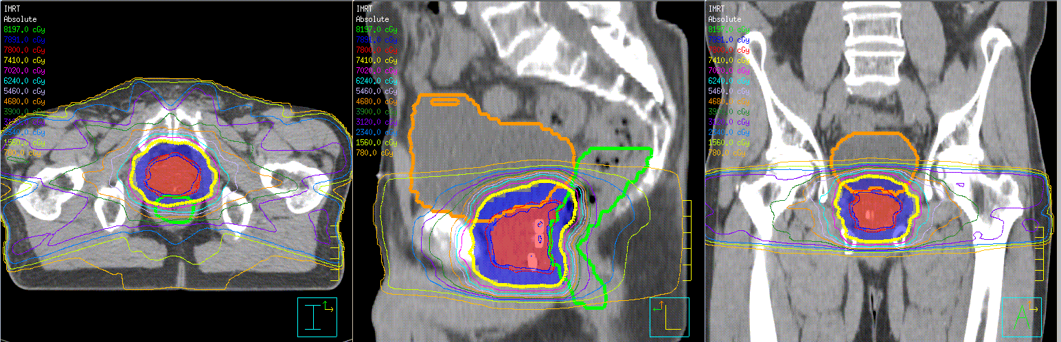
Distribution IMRT
No beams

Slide 54
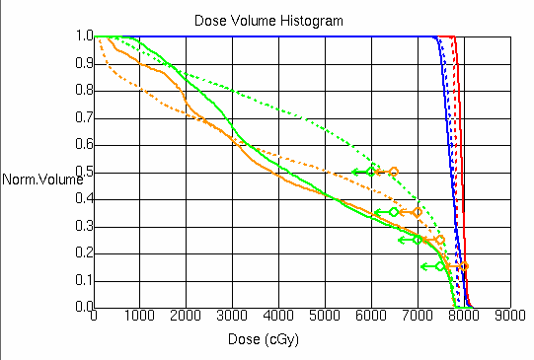
DVH – 3D CRT vs IMRT

Slide 55
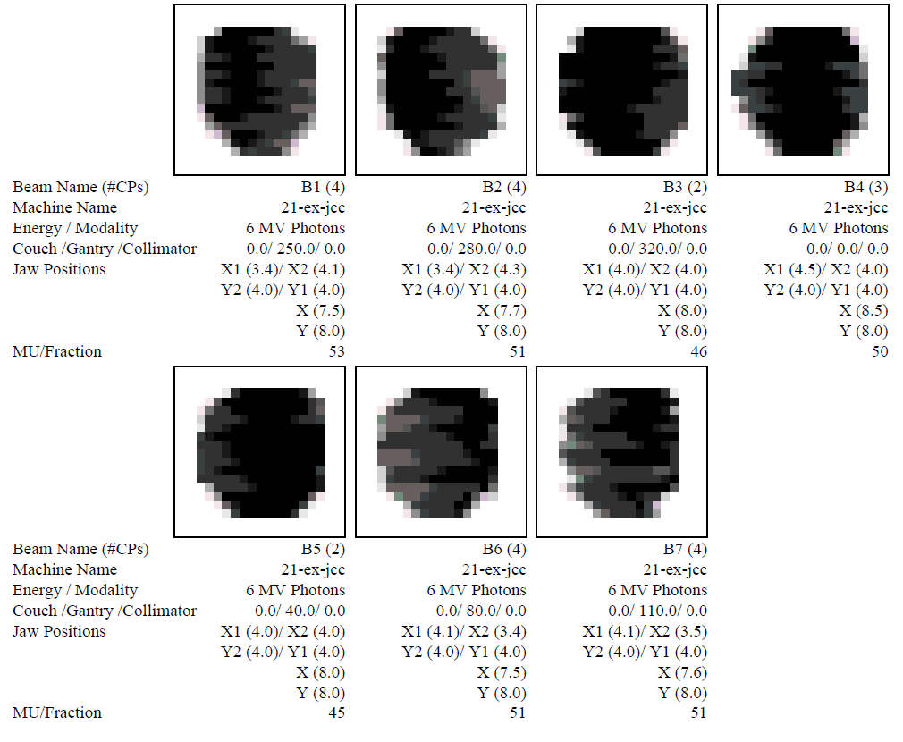
Field IMRT

Slide 56
Advances
IMRT
VMAT
Cyberknife

Slide 57
VMAT
Volumetric-Modulated Arc Therapy
Treatment with one or more arcs.
While rotating:
Radiation on continuously, but
Can change shape of area being treated
Can change output (amount of radiation)
Can change speed of rotation.

Slide 58
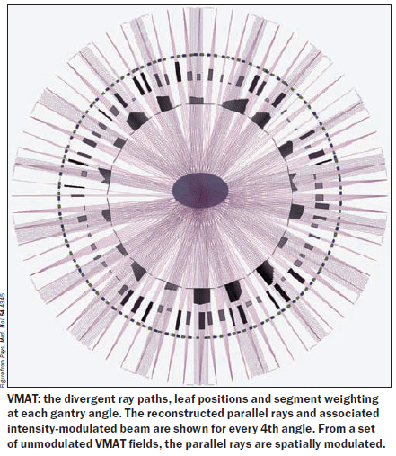

Slide 59
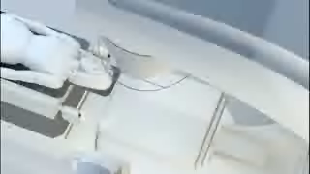
VMAT Video

Slide 60

Cyberknife video

Slide 61
Future
Hypofractionation with cyberknife or linear accelerator
RTOG trial: 5 versus 12 fractions

Slide 62
Radionuclides
⁸⁹St
¹⁵³Sm
²²³Ra

Slide 63
⁸⁹St β emitter T/2 50.5 days
Range ~8 mm
Energy 1.463 MeV
Has been shown to be useful in men with castrate resistant prostate cancer with multiple bone metastases. Was used more previously before docetaxel chemotherapy.

Slide 64
¹⁵³Sm β and γ emitter
β 640, 710, and 840 keV
γ 103 keV
T/2 46.3 days
Range 0.5 mm average, 3.0 mm maximum
Less marrow effects than ⁸⁹St

Slide 65
²²³Ra α emitter
T/2 11.43 days
Energy – max 27.7 MeV, average 6.94 Mev
Range ~1 mm
    tested in 1 study of men with castrate resistant disease. The median time to progression was 26 weeks with ²²³Ra versus 8 weeks for placebo. Median survival was 41% longer (65.3 weeks versus 46.4 weeks).
further study required

Slide 66
Adjuvant therapy
1 Hormone treatments
Abiaterone
MDV3100
TAK700
2 Growth Inhibitors
EGFR inhibitors
PIK3 inhibitors
Antisense oligonucleotides (heat shock protein)
3 Immunotherapy
Sipucel T treatment

Slide 67
Conclusions
Not all prostate cancers are created equal need to know PSA, Gleason score, T-stage to determine risk category.
Radiation therapy has a role in the treatment of all risk categories of prostate cancer.

Slide 68
Conformal radiation (IMRT / VMAT) is the mainstay of treatment for men with prostate cancer. IGRT is used in both of these methods.
Cyberknife (stereotactic body radio-surgery) is being explored as a potential treatment option.

Slide 69
Outcomes of treatment are similar with radiation and surgery.
Notes:
Brings us back full circle.

